Slide 1
Magnetic and Electrostatic Separation

Slide 2
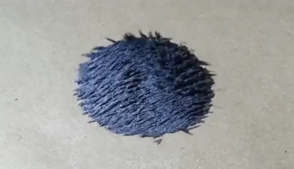
By the end of this Smart Lesson, you should be able to:
Explain how magnets and electrostatic force can be used to separate mixtures.
Compare electrostatic and magnetic forces as separation techniques.
Evaluate the strengths and limitations of each separation technique.

Slide 3
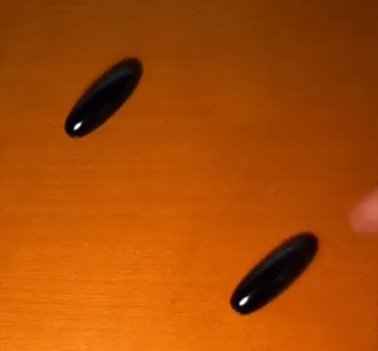
You've probably used a magnet before to pick up small bits of metal like paperclips or staples.
Magnets work because of the force of magnetism, which acts on the metals iron, nickel and cobalt.

Slide 4
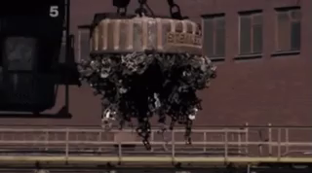
Very powerful magnets are able to collect and hold a lot of metal because the forces involved are so strong.
For example, huge electromagnets are used at metal scrapyards to move around large amounts of metal.

Slide 5
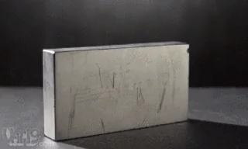
Magnetism is used to separate metals from other substances in a process called magnetic separation.
This is useful at places like recycling centres and rubbish dumps, where metal can be collected from piles of waste.
It can then be melted down to turn into new products.

Slide 6
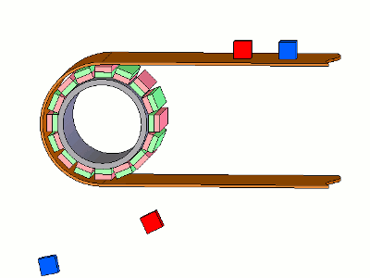
Magnetic separation is used in recycling centres.
Scraps are passed over a magnetic wheel. Iron, nickel and cobalt (magnetic metals) will attach to the wheel, but no other substances will.
The rest of the scrap falls away, leaving the magnetic metals to drop off in a separate container.

Slide 7
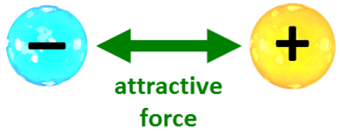
Electrostatic forces work by the attraction of charged particles.
Charge can be a complicated concept, but it works due to two basic principles:
1. There are positive and negative particles in all substances.
2. These opposing forces are attracted to each other.

Slide 8
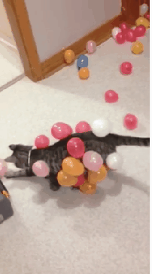
A common example of this occurs when you rub a balloon in your hair.
Rubbing a balloon against your hair gives different charges to the balloon and your hair. Your hair then sticks to the balloon because the two charges are attracted to each other. It is very similar to how the north and south poles of a magnet are attracted to each other.

Slide 9
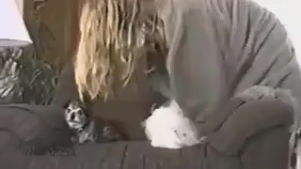
We can use the attraction between charges to separate charged particles from a mixture.
If we charge things, then they move with the electrostatic force. More objects can be charged than can be magnetised.
However, the attraction between charges is much weaker than the attraction between magnets.

Slide 10
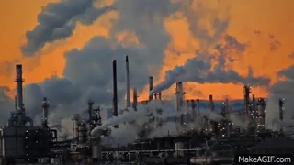
Electrostatic charging is used in chimneys to separate smoke from other gas particles.
Smoke can be removed from a chimney by installing charged plates. Smoke particles are charged and are attracted to the charged plates.
This stops smoke from being released into the atmosphere. Particles hit the charged plates and are collected instead.
We can also use charge separation in mining to isolate useful minerals from rock.

